Slide 1
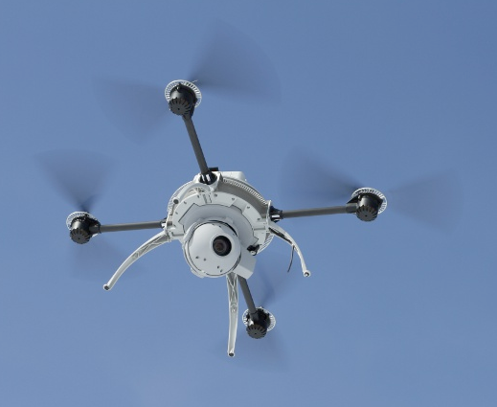
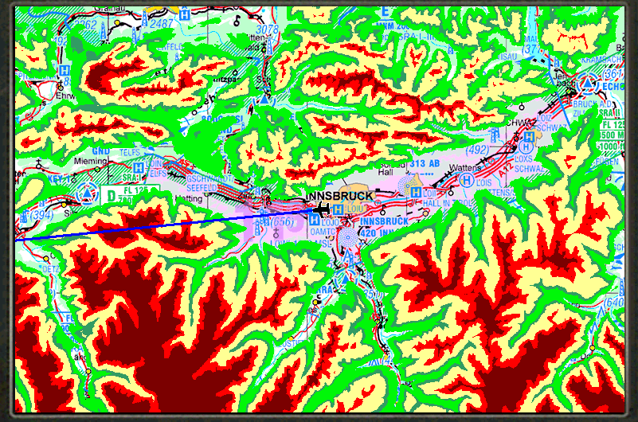
Quadrotor Terrain Mapping with Subterranean Scanning
Power/
Recharging
Radar/RF/
PCB
Backscatter/
processing
Data Collection/
Visualization
Project with Dr. Chamberland and Dr. Huff
To build a quadcopter capable of radar imaging for aerial mapping of the terrain of regions
Further improvement of the system would allow for ground penetration radar
Modular Project
4 Components that work together but can continue to work separately if provided similar inputs
Lotanna - Management of the quadcopter and power use, designing and implementing a recharging platform to be used in unfavorably flying conditions with the use of alternative energy.
Blade - Design and implementation of the radar and RF portions of the project including PCB design. Output results to be deciphered by Cameron’s Module.
Cameron - Interpretation of the backscatter of the signal for processing. Processed data to be collected and used by Matthan’s Module.
Matthan - Collecting and organizing backscatter data for visualization on a desktop through a network.
Agriculture - Dr. Huff has spoken of interest from the agriculture department to use this system to improve the research involving tree root systems. This system would allow for scanning a root system without the excavation of the site.

